Slide 1


Social Buzz
Data Analysis

Slide 2


Today's agenda
Project recap
Problem
The Analytics team
Process
Insights
Summary

Slide 3

S
Social Buzz, a swiftly growing unicorn in the technology sector, is adapting to its expanding global footprint. As part of a three-month Proof of Concept (POC), Accenture has initiated the following tasks:
Conducting a comprehensive examination of Social Buzz's utilization of big data.
Formulating strategies to ensure a successful Initial Public Offering (IPO).
Analyzing and determining the top 5 content categories on Social Buzz.
Project Recap

Slide 4

Problem
In recent years, the customer base for Social Buzz has expanded immensely, surpassing the capacity of their internal resources to effectively manage it. On a daily basis, Social Buzz encounters over 100,000 posts, accumulating to 36,500,000 posts annually. Given that all content is unstructured, comprehending such a vast amount can pose a significant challenge.
To address this, specific project specifications have been identified, including:
Combining tables from the sample dataset for comprehensive analysis.
Conducting an in-depth analysis of content categories to pinpoint the top five with the highest total popularity

Slide 5

Data Analyst – Disha Varshney

Slide 6
Process
1
Data Comprehension
2
Data Wrangling
3
Data Modelling
4
Data Examination
5
Data Exploration

Slide 7

Insights
ANIMALS
Most Popular Category
16
962
16
Unique Categories
Unique Contents
Unique Reaction Types

Slide 8
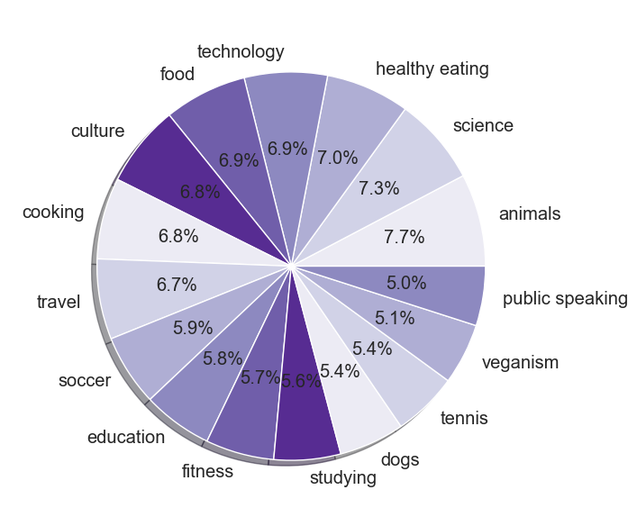
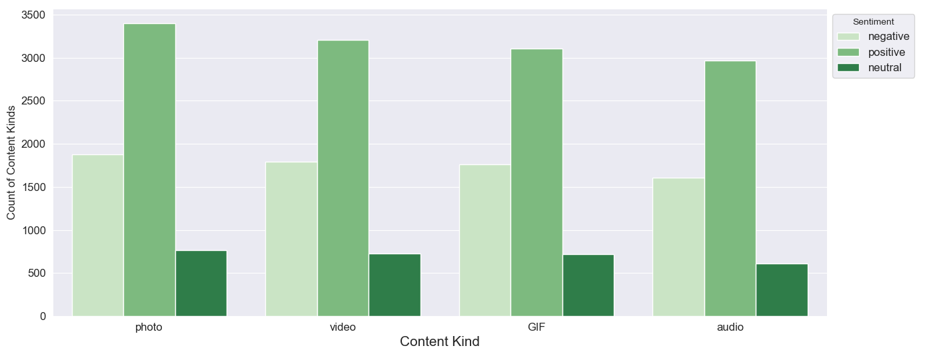
Distribution of Distinct Categories
Distribution of Sentiment by Content Kind

Slide 9
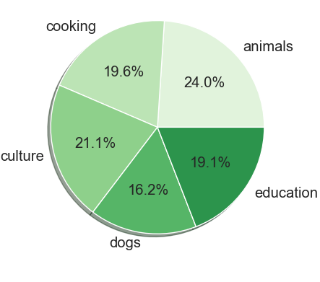
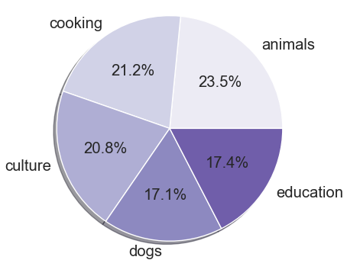
Top 5 Categories in 2020
Top 5 Categories in 2021

Slide 10
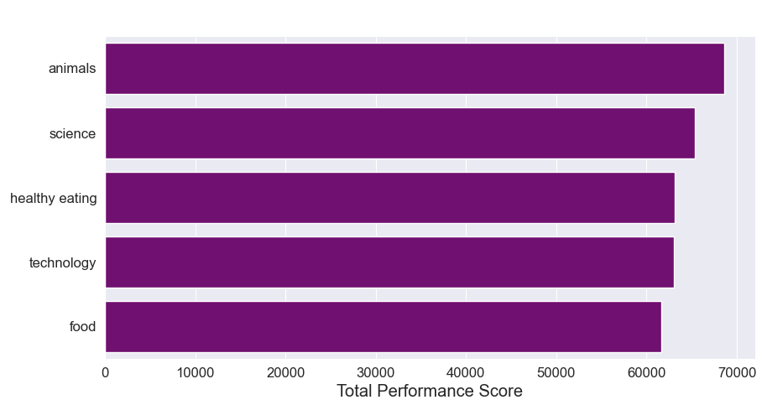
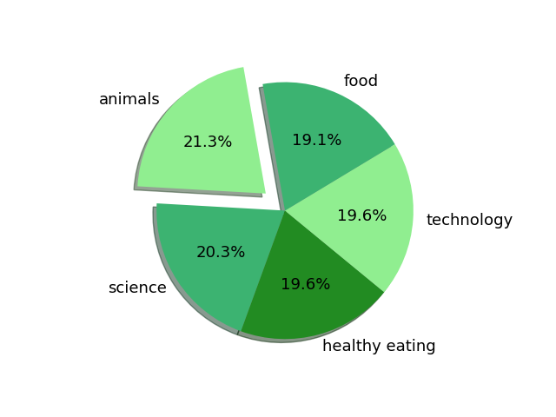
Top 5 Categories based on their Performance Score

Slide 11
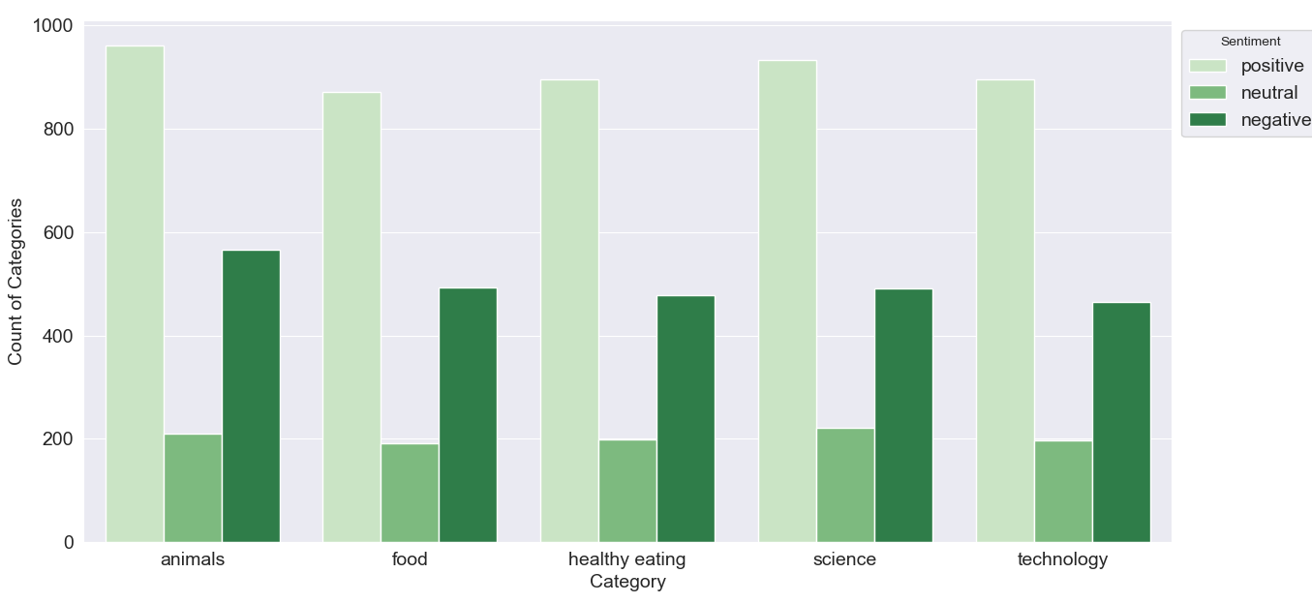
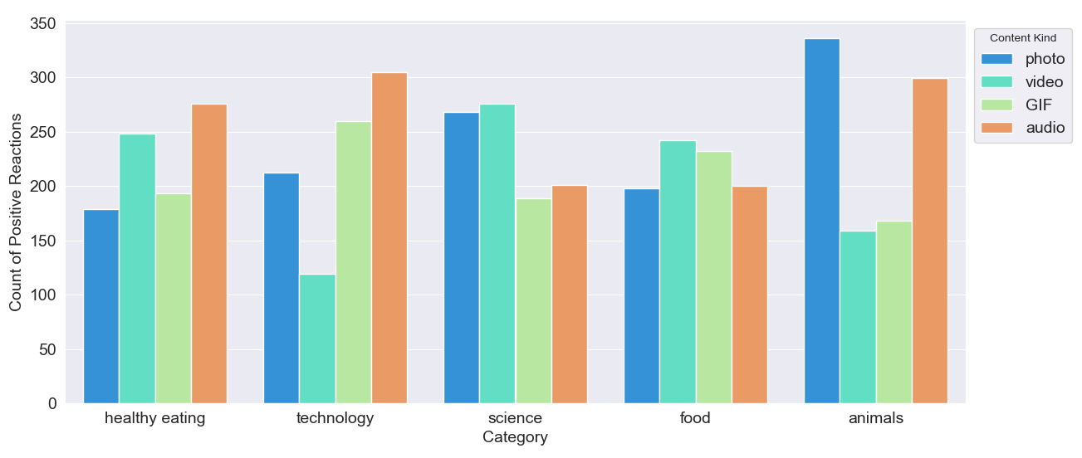
Distribution of Sentiment in Top 5 Categories
Distribution of Positive Reactions by Content Kind in Top 5 Categories

Slide 12
Summary
Animals, Food, Science, Technology, and Healthy Eating are the top five most popular categories among viewers over the past two years. Producing content related to these fields would be advantageous
Animals is the category that has received the maximum positive as well as negative reactions. The second category to garner high positive reactions is Science. Shifting the content in these categories towards the positive side will help attract more users
Analyzing the data reveals that the content format (photo, audio, video, GIF) greatly impacts positive reactions in the top 5 categories. For instance, 'Animals' generates the highest positive responses with 'photo' content. Optimal 'Content Kind' choices for these categories can enhance positive user engagement

Slide 13
Thank you!
ANY QUESTIONS?

